Slide 1


Oscar Urquiza
May 9th, 2023

Slide 2

Outline
Executive Summary
Introduction
Methodology
Results
Conclusion
Appendix

Slide 3
Executive Summary
Methodologies:
Data collection API
Data collection with web scraping
Data wrangling
Exploratory analysis using SQL and visualization
Interactive visual analytics with Folium
Machine Learning predictive analysis
Results:
Exploratory data analysis result
Interactive analytics in screenshots
Predictive analytics result from machine learning

Slide 4
Introduction
Context:
SpaceX promotes Falcon 9 rocket launches at a cost of 62 million dollars, which is significantly less than its competitors who charge over 165 million dollars for a single launch. The reason for these massive cost savings is SpaceX's ability to reuse the first stage of the rocket and therefore avoiding the costs of making it over again. Thus, being able to determine whether the first stage will land successfully can help determine the total launch cost. Our goal is to develop a machine learning pipeline that can predict whether the first stage of the Falcon 9 rocket will land successfully and help us to identify the right price to bid against SpaceX for a rocket launch.
Questions:
What are the key factors that result in a successful launch?
How can we combine factors to create a successful launch environment?

Slide 5

Section 1

Slide 6
Methodology
Executive Summary
Data collection methodology:
SpaceX REST API and web scraping from Wikipedia
Perform data wrangling
One-hot encoding was applied to categorical features
Perform exploratory data analysis (EDA) using visualization and SQL
Perform interactive visual analytics using Folium and Plotly Dash
Perform predictive analysis using classification models
How to build, tune, evaluate classification models

Slide 7
Data Collection
The act of obtaining and measuring specific information within a set framework in order to answer pertinent questions and assess results is referred to as data collection. In this case, the information was compiled using SpaceX’s REST API and web scraping from Wikipedia.
To utilize the REST API, we began with a GET request, decoded the response content as JSON, and transformed it into a pandas dataframe via json_normalize().
We then scrubbed the data, identified any missing values, and filled in any gaps as necessary.
For web scraping, we will rely on BeautifulSoup to extract the launch records as an HTML table, parse the table, and then convert it into a pandas dataframe for further analysis.

Slide 8
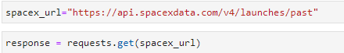
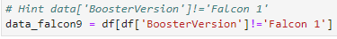
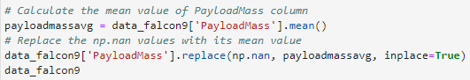
Data Collection – SpaceX API
Used GET request for rocket launch data using SpaceX REST API
Use JSON to normalize data and turn into a Pandas dataframe
Filter the data and replace missing values
https://github.com/oscarurquiza7/Data-Science-Capstone/blob/2d9dea80d51d052f04731515a8107941db0e33c6/Data_Collection_API.ipynb

Slide 9
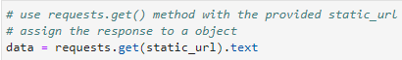
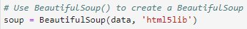
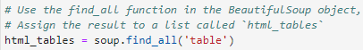
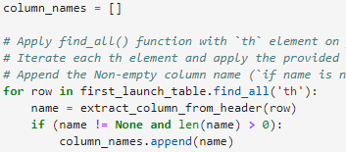
Data Collection - Scraping
Use a GET request on the Falcon9 launch wiki
Create BeautifulSoup from the HTML response
Extract the columns names from the header
https://github.com/oscarurquiza7/Data-Science-Capstone/blob/581faa4600eda546fe895d6c2a2ae7c9a7f989ce/Webscraping.ipynb

Slide 10
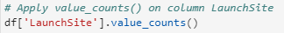
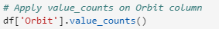
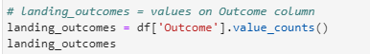
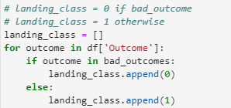
Data Wrangling
Started by counting the number of launches per site as well as the number of each orbit
Looked at the landing outcomes for each launch
Labeled our data based on the outcome of the landing in order to differentiate bad outcomes from good outcomes
https://cf-courses-data.s3.us.cloud-object-storage.appdomain.cloud/jupyterlite/lab?path=IBM-DS0321EN-SkillsNetwork%2Flabs%2Fmodule_1_L3%2Flabs-jupyter-spacex-data_wrangling_jupyterlite.jupyterlite.ipynb

Slide 11
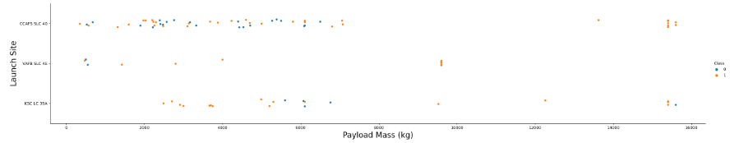
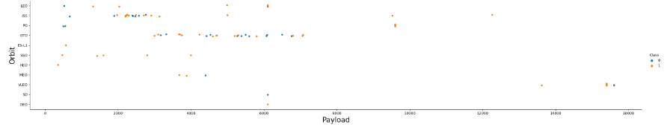
EDA with Data Visualization
We plotted a few graphs to understand the relationships among variables such as:
Payload vs Flight Number
Launch Site vs Flight Number
Launch Site vs Payload
Orbit vs Flight Number
Orbit vs Payload
https://cf-courses-data.s3.us.cloud-object-storage.appdomain.cloud/jupyterlite/lab?path=IBM-DS0321EN-SkillsNetwork%2Flabs%2Fmodule_2%2Fjupyter-labs-eda-dataviz.ipynb.jupyterlite.ipynb

Slide 12
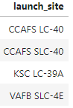
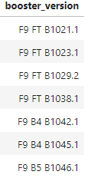
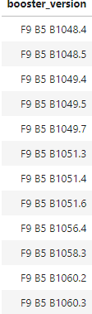
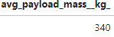
EDA with SQL
Looked at all our launch sites
Followed up by checking the average payload mass carried by booster version F9 v1.1
Listed the name of successful boosters with a payload mass between 4000 and 6000 kg
Looked at boosters that have carried the maximum payload mass
https://github.com/oscarurquiza7/Data-Science-Capstone/blob/033c33815ecb48be599369f1c613edd8403962f4/EDA_SQL.ipynb

Slide 13
Build an Interactive Map with Folium
We marked all launch sites and added highlighted circles around them
We color coded the launch sites based on successful launches
We marked all the proximities for the launch sites (coastlines, highways, railways, etc.)
These features allow us to understand the surroundings of successful and unsuccessful launch sites.
https://github.com/oscarurquiza7/Data-Science-Capstone/blob/8647bd18c74369e134003c4e580d2c851d440989/lab_jupyter_launch_site_location.jupyterlite.ipynb

Slide 14
Build a Dashboard with Plotly Dash
We have pie charts that show us the count of successful launches per site
We have an interactive scatter plot with a slider that allows us to check success counts for different ranges of payload mass
These are all useful features for identifying which sites have the most success as well as understanding what the relationship between payload mass and success is
https://github.com/oscarurquiza7/Data-Science-Capstone/blob/8647bd18c74369e134003c4e580d2c851d440989/spacex_dash_app.py

Slide 15
Predictive Analysis (Classification)
We started by standardizing our data and splitting it into a training and testing set
We built four models: logistic regression, support vector machine (svm), decision tree, and k nearest neighbors (knn)
We fit each model to first find the best parameters and then checked its accuracy against the validation data
Once we had this, we scored each model by testing it against the test data
https://github.com/oscarurquiza7/Data-Science-Capstone/blob/a03ae077631b99f6c9c5eef40e23c09a942348ef/IBM-DS0321EN-SkillsNetwork_labs_module_4_SpaceX_Machine_Learning_Prediction_Part_5.jupyterlite%20(1).ipynb

Slide 16
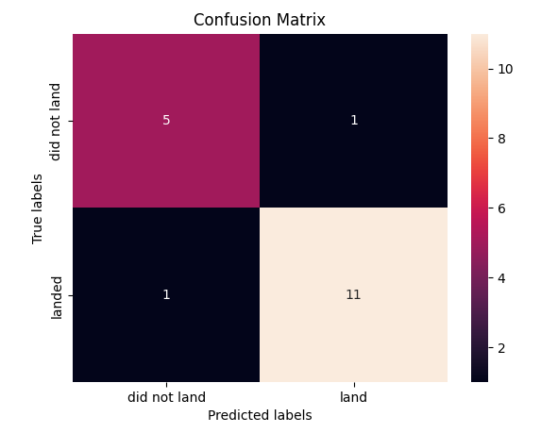
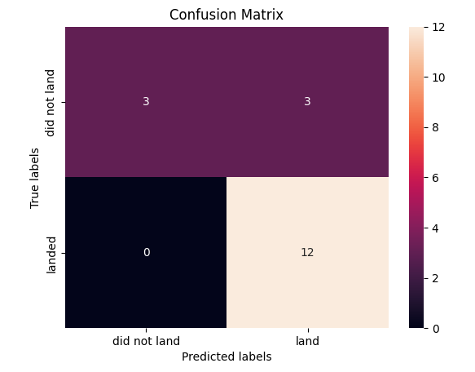
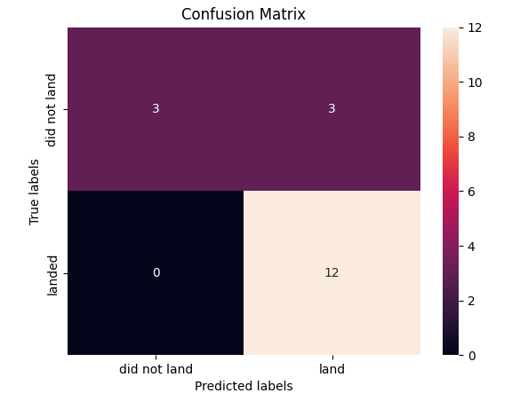
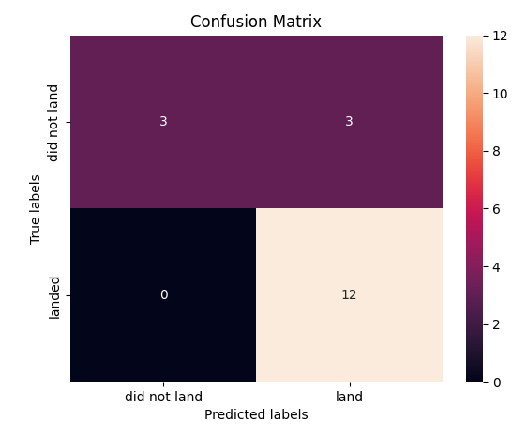
Results

Slide 17

Section 2

Slide 18

Flight Number vs. Launch Site
From the plot, we found that the larger the flight amount at a launch site, the greater the success rate at a launch site.

Slide 19


Payload vs. Launch Site

Slide 20

Success Rate vs. Orbit Type
From the plot, we can see that ES-L1, GEO, HEO, SSO, VLEO had the most success rate.

Slide 21

Flight Number vs. Orbit Type
The plot below shows the Flight Number vs. Orbit type. We observe that in the LEO orbit, success is related to the number of flights whereas in the GTO orbit, there is no relationship between flight number and the orbit.

Slide 22

Payload vs. Orbit Type
We can observe that with heavy payloads, the successful landing are more for PO, LEO and ISS orbits.

Slide 23

Launch Success Yearly Trend
From the plot, we can observe that success rate since 2013 kept on increasing till 2020.

Slide 24

All Launch Site Names
We used the key word DISTINCT to show only unique launch sites from the SpaceX data.

Slide 25

Launch Site Names Begin with 'CCA'
We used the query above to display 5 records where launch sites begin with `CCA`

Slide 26

Total Payload Mass
We calculated the total payload carried by boosters from NASA as 45596 using the query below

Slide 27

Average Payload Mass by F9 v1.1
We calculated the average payload mass carried by booster version F9 v1.1 as 2928.4

Slide 28

First Successful Ground Landing Date
We observed that the dates of the first successful landing outcome on ground pad was 22nd December 2015

Slide 29

Successful Drone Ship Landing with Payload between 4000 and 6000
We used the WHERE clause to filter for boosters which have successfully landed on drone ship and applied the AND condition to determine successful landing with payload mass greater than 4000 but less than 6000

Slide 30

Total Number of Successful and Failure Mission Outcomes
We used wildcard like ‘%’ to filter for WHERE MissionOutcome was a success or a failure.

Slide 31

Boosters Carried Maximum Payload
We determined the booster that have carried the maximum payload using a subquery in the WHERE clause and the MAX() function.

Slide 32

2015 Launch Records
We used a combinations of the WHERE clause, LIKE, AND, and BETWEEN conditions to filter for failed landing outcomes in drone ship, their booster versions, and launch site names for year 2015

Slide 33

Rank Landing Outcomes Between 2010-06-04 and 2017-03-20
We selected Landing outcomes and the COUNT of landing outcomes from the data and used the WHERE clause to filter for landing outcomes BETWEEN 2010-06-04 to 2010-03-20.
We applied the GROUP BY clause to group the landing outcomes and the ORDER BY clause to order the grouped landing outcome in descending order.

Slide 34

Section 3

Slide 35

All launch sites global map markers

Slide 36

Markers showing launch sites with color labels

Slide 37

Launch Site distance to landmarks

Slide 38

Section 4

Slide 39

Pie chart showing the success percentage achieved by each launch site

Slide 40

Pie chart showing the Launch site with the highest launch success ratio

Slide 41

Scatter plot of Payload vs Launch Outcome for all sites, with different payload selected in the range slider

Slide 42

Section 5

Slide 43

Classification Accuracy
The decision tree classifier is the model with the highest classification accuracy

Slide 44

Confusion Matrix
The confusion matrix for the decision tree classifier shows that the classifier can distinguish between the different classes. The major problem is the false positives .i.e., unsuccessful landing marked as successful landing by the classifier.

Slide 45
Conclusions
We can conclude that:
The larger the flight amount at a launch site, the greater the success rate at a launch site.
Launch success rate started to increase in 2013 till 2020.
Orbits ES-L1, GEO, HEO, SSO, VLEO had the most success rate.
KSC LC-39A had the most successful launches of any sites.
The Decision tree classifier is the best machine learning algorithm for this task.

Slide 46


